Slide 1
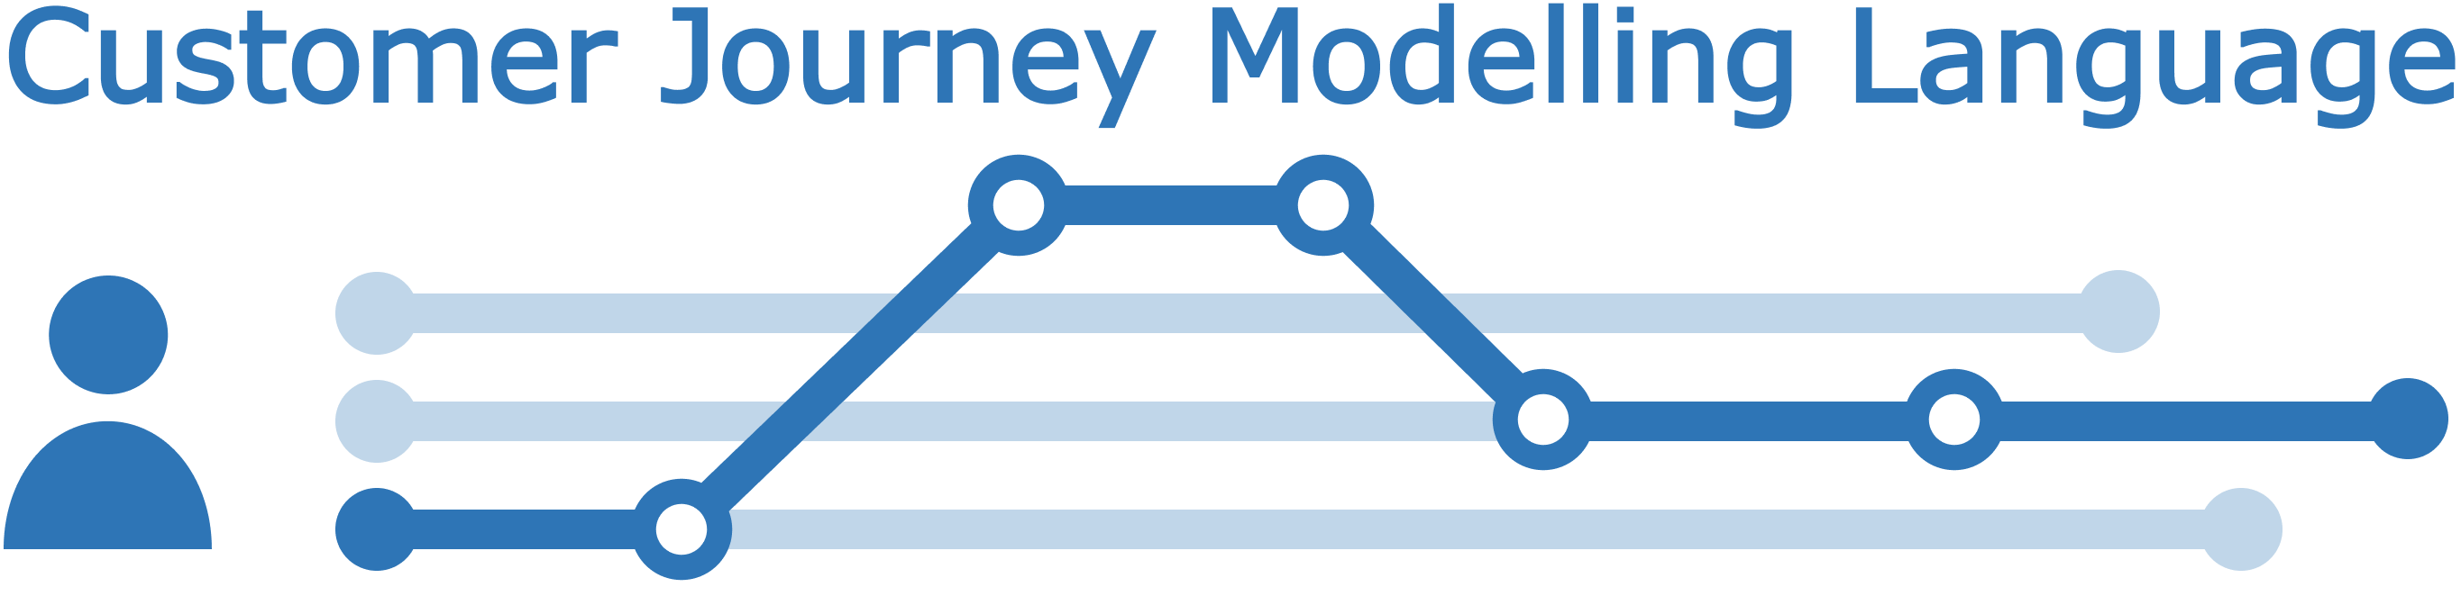
Terminology CJML - Customer Journey Modelling Language
Version 2.0
SINTEF Digital
November 2022

Slide 2


Overview of CJML 2.0 resources
Introduction
Overview, purpose and target group
Modelling approach
Visual notation
Diagrams types and symbols
Features and examples
Diagram generator
Templates for easy diagramming
Examples
The CJML material consists of several modules that are to be seen in connection to each other. All the CJML resources can be found here: www.cjml.no
Main change in this version:
An expanded terminology and a data exchange format
Change in the visual notation of the journey network diagram (message flow between sender and receiver)
Terminology
Definitions, attributes, and class diagrams
Meta-model
Data format
XML schema
XML examples
XML description

Slide 3


How to use this material?
CJML v2.0 by SINTEF Digital is licensed under a Creative Commons Attribution-ShareAlike 4.0 International License.
Anyone can use, copy, and transform the material in any medium or format – for any purpose – under the following terms:
Attribution: You must give appropriate credit, provide a link to the license, and indicate if changes were made
ShareAlike: If you remix, transform, or build upon the material, you must distribute your contributions under the same license as the original.
Guidance on how to give appropriate credit can be found here:
https://creativecommons.org/use-remix/
https://wiki.creativecommons.org/wiki/Best_practices_for_attribution
The current version of CJML was released through the research project Smart Journey Mining funded by the Research Council of Norway (grant no. 312198).

Slide 4
Contents
Readers guide
Who can use this material?
Additional resources
About the terminology
Overview - CJML metamodel
About metamodels
CJML simplified metamodel
Terms
Customer journey
Planned journey
Actual journey
Touchpoint
Planned touchpoint
Actual touchpoint
Planned communication point
Actual communication point
Planned action
Actual action
Initiator
Receiver
Channel
Message
Back-end system
Object
End-user experience
Journey phase
Journey operator
Concurrency
Decision
Actor
Service provider
End-user
External
CJML metamodel
Complete metamodel
Complete metamodel with attributes

Slide 5
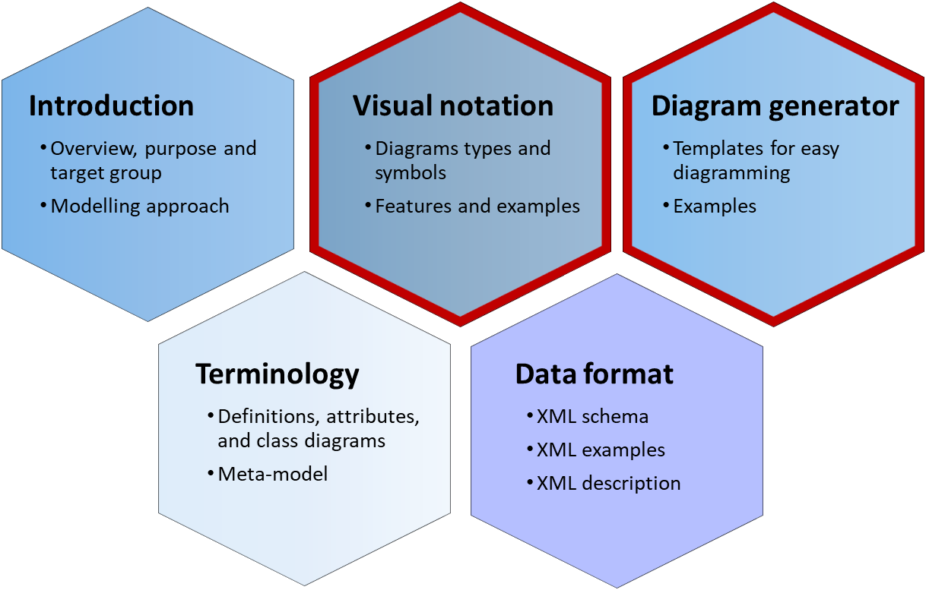
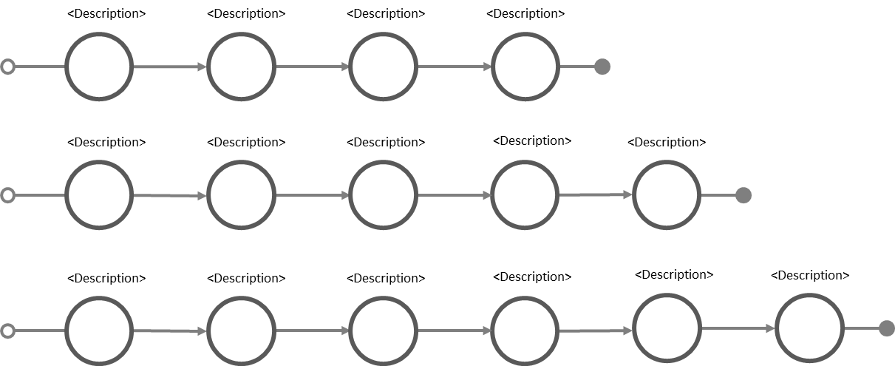
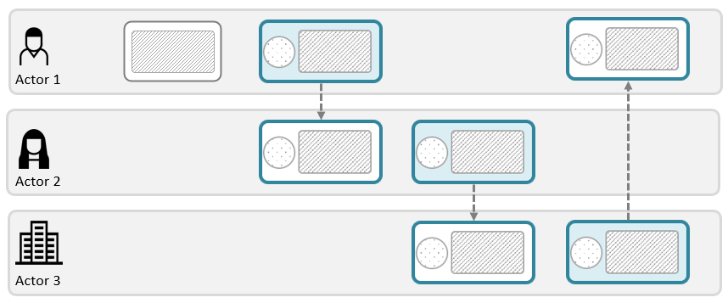
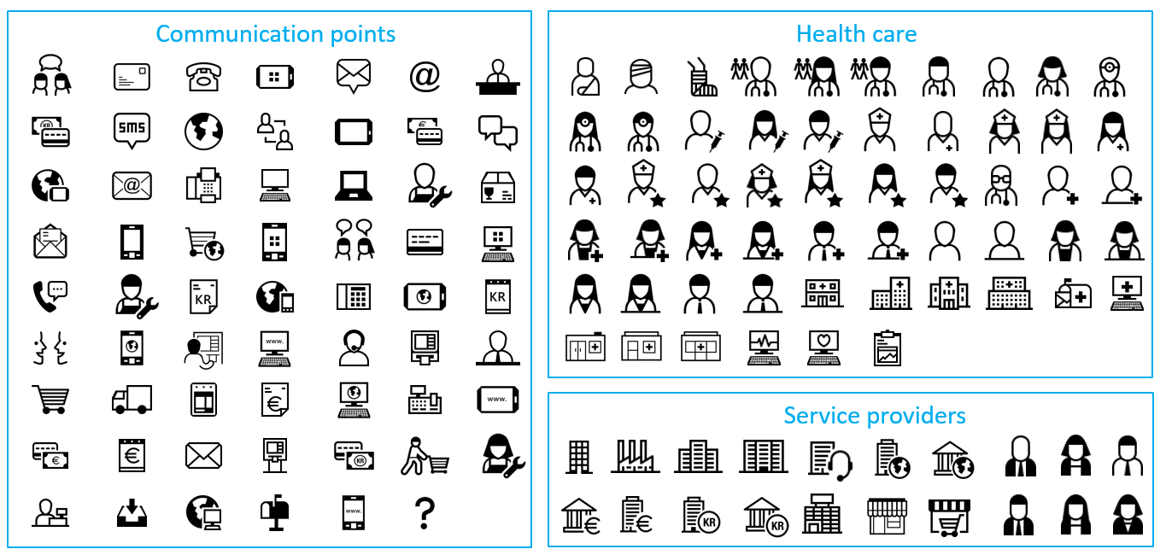
Additional CJML resources
These modules contain support for making diagrams
Please visit the CJML web page www.cjml.no
Alternatives for creating diagrams:
Simply copy-paste elements from the Visual notation slides and modify for your own use
Use the templates in the Diagram generator slides
Download the graphical elements in bitmap or vector format
See the web page for other visual tools
Template – simple journey diagram
Template – journey network diagram
Symbol gallery

Slide 6
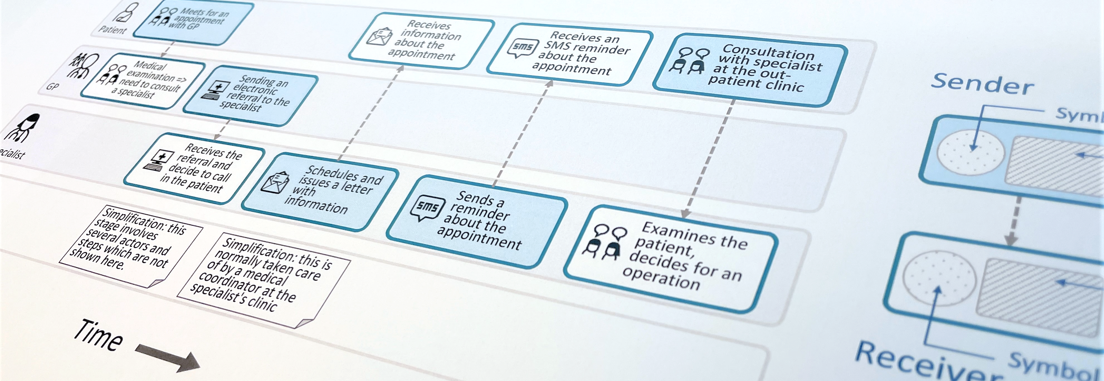
CJML - Customer Journey Modelling Language
CJML is a visual language dedicated to modelling of human journeys, regardless of whether the human has the role of customer, user, patient, or citizen.
Customer journey
User journey
Employee journey
Patient journey
Citizen journey

Slide 7
About the terminology

Slide 8
Terminology
Each term (or class) is described using:
a table that elaborates the term
a subset of the metamodel referring to the term described using UML class diagram
The format for the table and the metamodel will be described in the next two slides
The terms mentioned here is also used in the CJML data format.
The data for each class (term) is composed of its attributes and relationships expressed using UML

Slide 9
Terminology - table
Definition & source | A formal definition of the term used. Some definitions are new while others are adopted from the literature. In the case of adopted definition, a source of the definition is accompanied in this field.
Note | Some useful notes regarding the term being described
Synonym(s) | Lists similar terms identified in the literature
Attribute(s) | Lists the attributes of the class being discussed. Includes the attributes that are inherited from the parent classes
Relationship(s) | Describes the related terms following the UML class diagram notation (e.g., child/parent terms, associated terms, composition/aggregation, constraints in simple text.

Slide 10
Terminology - metamodel
UML relationships used:
Class diagram template:
multiplicity
Association
Inheritance
Aggregation
Note/Comment
Class
attribute1: Data Type attribute2: Data type . . attributeN: Data Type
endpoint name [0..*]
Associated Class
endpoint name [0..*]
Aggregated Class
Data types used:
Data Type | Short Description
String | a textual format
Integer | a numeric data format (whole numbers)
Float | numeric data format with decimal values
Boolean | data format with true or false values
Datetime | non-primitive; date and time format
Subclass 1
Subclass 2
comments, notes, and constraints

Slide 11
Overview of the CJML meta-model
About meta-models in general
CJML simplified meta-model

Slide 12
About meta-models in general
What is a meta-model?
A meta-model is "a model of a modelling language ". It describes the structure, semantics and constraints of a model (Mellor, 2004).
A meta-model illustrates a higher level of abstraction than the modelling language itself
It describes the structure, semantics and constraints of a language
Why do we use meta-model?
The use of a meta-model makes language definitions easier to understand and the definitions can possibly be integrated and manipulated in the same way as system models (Evans et al., 2003).
Meta-models offer the facilities which support the design of models (Akehurst and Patrascoiu, 2003).
Examples of meta-modelling language
UML (Unified Modelling Language)
SysML (Systems Modeling Language)

Slide 13
CJML simplified metamodel
Theory
Planned Communication Point
Planned Journey
plannedTouchpoints [2..*]
Planned Touchpoint
Planned Action
Customer Journey
Touchpoint
Actor
endUsers [1..*]
End User
Service Provider
actualTouchpoints [2..*]
Actual Communication Point
serviceProviders [1..*]
Actual Journey
Actual Touchpoint
Actual Action
Real-world

Slide 14
Terms and class diagrams
Customer journey
Planned journey
Actual journey
Touchpoint
Planned touchpoint
Actual touchpoint
Planned communication point
Actual communication point
Planned action
Actual action
Initiator
Receiver
Channel
Message
Back-end system
Object
End-user experience
Journey phase
Journey operator
Concurrency
Decision
Actor
Service provider
End-user
External

Slide 15
Customer Journey
Definition & source | A sequence or constellation of touchpoints involved for a customer to achieve a specific goal or a desired outcome in the context of a service process
Note | The term is generally used as a to examine a service system from the customer’s perspective; "a walk in the customer shoes" (Holmlid & Evensson, 2008). As the journey concept has been taken up in non-commercial service contexts, practitioners and academics have expanded the role of the end-user to users, consumers, patients, and citizens.
Synonym(s) | service encounter, service process, customer path
Attribute(s) | journeyID – the system identifier of a particular journey journeyTitle – a short journey title journeyShortSummary – a short summary of what the journey is about journeyLongSummary – a long summary of what the journey is about comment - comments that can be stated for a specific journey
Relationship(s) | Involves at least one end-user, and one service provider. It can have multiple expected actors (end users and service providers) and external actors as well. It can have journey phases and journey operators if they are present. A customer journey can be either planned or actual.
End User
[1..*] endUsers
Customer Journey
journeyID: String journeyTitle: String journeyShortSummary: String journeyLongSummary: String comment: String
journeyPhases [0..*]
Journey Phase
Service Provider
[1..*] serviceProviders
journeyOperators [0..*]
Journey Operator
External
[0..*] externals
Planned Journey
Actual Journey

Slide 16
Planned Journey
Definition & source | The end-user journey as prescribed by the service provider(s) involved (deliberately or not).
Note | CJML distinguishes between the hypothetical, planned journey and the dynamic, actual journey that unfolds during the execution of a service.. Planned journeys corresponds to the potential state of Shostack's model (1982)
Synonym(s) | planned customer path, customer-facing service process, planned service process, intended journey, “happy path”.
Attribute(s) | journeyID – the system identifier of a particular journey journeyTitle – a short journey title journeyShortSummary – a short summary of what the journey concerns journeyLongSummary – a long summary of what the journey comment - comments that can be stated for a specific journey
Relationship(s) | Contains (atleast) 2 or more planned touchpoints
Planned Journey
journeyID: String journeyTitle: String journeyShortSummary: String journeyLongSummary: String comment: String
plannedTouchpoints [2..*]
Planned Touchpoint

Slide 17
Actual Journey
Definition & source | The real journey as experienced by an end-user
Note | Actual journeys correspond to the kinetic state of Shostack's model (1982)
Synonym(s) | Actual service encounter, actual service process, actual customer path, kinetic state
Attribute(s) | journeyID – the system identifier of a particular journey journeyTitle – a short journey title journeyShortSummary – a short summary of what the journey is about (OPTIONAL) journeyLongSummary – a long summary of what the journey is about (OPTIONAL) journeyStatus – current status of the journey, either it is currently in-progress, or have completed with respect to the planned journey contentCompliance – returns TRUE if all the actual touchpoints corresponds with the planned touchpoints sequenceCompliance – returns TRUE if the sequence of actual touchpoints corresponds with the sequence of the planned touchpoints timingCompliance – returns TRUE if all the start times of each actual touchpoints fall within the "allowed" times declared in the planned touchpoints comment - comments that can be stated for a specific journey
Relationship(s) | Contains (atleast) 2 or more actual touchpoints, a journey-level experience, and associated to a planned journey for its compliance
Actual Journey
journeyID: String journeyTitle: String journeyShortSummary: String journeyLongSummary: String journeyStatus: status plannedReference: String contentCompliance: Boolean sequenceCompliance: Boolean timingCompliance: Boolean comment: String
actualTouchpoints [2..*]
Planned Journey
journeyCompliance [0..1]
Actual Touchpoint
journeyExperience [0..1]
End User Experience
<<Enumeration>> status
inProgress completed aborted

Slide 18
Touchpoint
Definition & source | A step in a customer journey
Note | Touchpoints are the main components of CJML and can be seen as the "grammar" of the CJML language.
Synonym(s) | Contact point, episode, incidents, service encounter, interaction point, moment of truth, service touchpoint, service contact
Attribute(s) | touchpointID – an alphanumeric ID specific for Touchpoints; starts at T₁ to T_{n} where n is the total number of touchpoints in a single journey uncertainty – a feature of a touchpoint to incorporate flexibility in situation that incurs uncertainty; can have multiple values of uncertainty (up to 4, the number of possible values) comment - comments that can be stated for a specific journey
Relationship(s) | A Touchpoint can be associated to Objects, Systems, and may belong to a specific Journey Phase.
Touchpoint
touchpointID: String uncertainty: uncertaintyValues [0..4] comment: String
objects [0..*]
<<Enumeration>> uncertaintyValues
uncertainOccurrence uncertainNoOfOccurrence uncertainChannel uncertainInitiator
belongsTo [0..1]
Object
Journey Phase
systems [0..*]
Backend System
Planned Touchpoint
Actual Touchpoint

Slide 19
Planned Touchpoint
Definition & source | A step in a planned journey
Note | Though the planned times are in float format in the metamodel, the default xsd:duration format is used in the XML data format
Synonym(s) | Contact point, episode, incidents, service encounter, interaction point, moment of truth, service touchpoint, service contact
Attribute(s) | touchpointID – an alphanumeric ID specific for Touchpoints; starts at T₁ to T_{n} where n is the total number of touchpoints in a single journey uncertainty – a feature to include an information regarding the uncertainty of occurrence, channel, and initiator; can have multiple values of uncertainty (up to 4, the number of possible values) comment – comments that can be stated for a specific journey deltaTime – inter- touchpoint planned starting time (millisecond) touchpointDuration – planned duration for each planned touchpoint (millisecond)
Relationship(s) | A Planned Touchpoint can be a Planned Action or a Planned communication Point. A Touchpoint can be associated to Objects, Systems, and may belong to a specific Journey Phase.
<<Enumeration>> uncertaintyValues
uncertainOccurrence uncertainNoOfOccurrence uncertainChannel uncertainInitiator
Planned Touchpoint
touchpointID: String deltaTime: Float touchpointDuration: Float uncertainty: uncertaintyValues [0..4] comment: String
Planned Action
Planned Communication Point

Slide 20




Planned Touchpoint – example of planned times
Delta Time
inter- touchpoint starting time
0
20Minutes
10Minutes
2Hours
2Days
T1
T2
T3
T4
T5
Orders a book online
Pays through debit card
Receives order confirmation
Receives delivery confirmation
Receives delivery in the mailbox
5Minutes
5Minutes
5Minutes
1Hour
5Minutes
Touchpoint Duration
Planned duration for each touchpoint

Slide 21
Actual Touchpoint
Definition & source | A step in an actual journey
Note | The separation of actual and planned touchpoint was introduced in CJML v2.0
Synonym(s) | Contact point, episode, incidents, service encounter, interaction point, moment of truth, service touchpoint, service contact
Attribute(s) | touchpointID – an alphanumeric ID specific for Touchpoints; starts at T₁ to T_{n} where n is the total number of touchpoints in a single journey uncertainty – a feature to include an information regarding the uncertainty of occurrence, channel, and initiator; can have multiple values of uncertainty (up to 4, the number of possible values) comment – comments that can be stated for a specific journey timeStarted – A timestamp value that indicates the time the touchpoint has started timeCompleted – A timestamp value that indicates the time the touchpoint has completed compliance – checks whether a real-world touchpoint respects the planned touchpoint, missing or failing. In case of an adhoc, this is an unintended touchpoint that is not present in a planned journey
Relationship(s) | An Actual Touchpoint can be an Actual Action or an Actual communication Point and may contain an End User Experience. A Touchpoint can be associated to Objects, Systems, and may belong to a specific Journey Phase.
Actual Touchpoint
touchpointID: String timeStarted: Datetime timeCompleted: Datetime compliance: complianceValues uncertainty: uncertaintyValues [0..4] comment: String
<<Enumeration>> complianceValues
planned missing failing adhoc
touchpointExperience [0..1]
End User Experience
<<Enumeration>> uncertaintyValues
uncertainOccurrence uncertainNoOfOccurrence uncertainChannel uncertainInitiator
Actual Action
Actual Communication Point

Slide 22
Planned Communication Point
Definition & source | A planned communication or interaction between two actors
Note | The difference between action and communication points is the presence of a communication medium and message for the communication point. Though the planned times are in float format in the metamodel, the default xsd:duration format is used in the XML data format.
Synonym(s) | Contact point, episode, incidents, service encounter, interaction point, moment of truth, service touchpoint, service contact
Attribute(s) | touchpointID – an alphanumeric ID specific for Touchpoints; starts at T₁ to T_{n} where n is the total number of touchpoints in a single journey uncertainty – a feature to include an information regarding the uncertainty of occurrence, channel, and initiator; can have multiple values of uncertainty (up to 4, the number of possible values) comment – comments that can be stated for a specific journey deltaTime – inter- touchpoint planned starting time (default: milliseconds - flexible) touchpointDuration – planned duration for each planned touchpoint (default: milliseconds - flexible)
Relationship(s) | A Planned Communication Point is composed of exactly one Initiator, one Receiver, one Channel, and may have a Message. A Touchpoint can be associated to Objects, Systems, and may belong to a specific Journey Phase.
Planned Communication Point
touchpointID: String deltaTime: Float touchpointDuration: Float uncertainty: uncertaintyValues [0..4] comment: String
<<Enumeration>> uncertaintyValues
uncertainOccurrence uncertainNoOfOccurrence uncertainChannel uncertainInitiator
initiator [1..1]
Initiator
receiver [1..1]
Receiver
channel [1..1]
Channel
message [1..1]
Message

Slide 23
Actual Communication Point
Definition & source | An instance of communication or interaction between two actors
Note | The difference between action and communication points is the presence of a communication medium for the communication point. The difference between actual and planned communication points are their times and the compliance. In case of using synchronous channels, timeStarted and timeCompleted are used. In case of using asynchronous channels, timeOriginated, timeAvailable, and timeConsumed are used.
Synonym(s) | Contact point, episode, incidents, service encounter, interaction point, moment of truth, service touchpoint, service contact
Attribute(s) | touchpointID – an alphanumeric ID specific for Touchpoints; starts at T₁ to T_{n} where n is the total number of touchpoints in a single journey uncertainty – a feature to include an information regarding the uncertainty of occurrence, channel, and initiator; can have multiple values of uncertainty (up to 4, the number of possible values) comment – comments that can be stated for a specific journey timeStarted – A timestamp value that indicates the time the touchpoint has started (for synchronous channels e.g., telephone) timeCompleted – A timestamp value that indicates the time the touchpoint has completed (for synchronous channels e.g., telephone) compliance – checks whether a real-world touchpoint respects the planned touchpoint, missing or failing. In case of an adhoc, this is an unintended touchpoint that is not present in a planned journey timeOriginated: A timestamp value that indicates the time when an asynchronous communication has been started by the initiator (e.g., email sent) timeAvailable: A timestamp value that indicates the time when an asynchronous communication became available to the receiver (e.g., email received) timeConsumed: A timestamp value that indicates the time when an asynchronous communication has been consumed by the receiver (e.g., email read)
Relationship(s) | A Planned Communication Point is composed of exactly one Initiator, one Receiver, one Channel, and may have a Message. A Touchpoint can be associated to Objects, Systems, and may belong to a specific Journey Phase.
Actual Communication Point
touchpointID: String timeStarted: Datetime timeCompleted: Datetime timeOriginated: Datetime timeAvailable: Datetime timeConsumed: Datetime compliance: complianceValues uncertainty: uncertaintyValues [0..4] comment: String
initiator [1..1]
Initiator
<<Enumeration>> uncertaintyValues
uncertainOccurrence uncertainNoOfOccurrence uncertainChannel uncertainInitiator
<<Enumeration>> complianceValues
planned missing failing adhoc
receiver [1..1]
Receiver
channel [1..1]
Channel
Message
message [0..1]

Slide 24
Planned Action
Definition & source | A planned activity conducted by an actor as part of a customer journey (that do not contain communication).
Note | An action do not involve direct communication, in contrast to a communication point. Example to distinguish communication points and actions: Action: signing a contract with a pen and scanning the contract Communication point: sending the contract through e-mail Though the planned times are in float format in the metamodel, the default xsd:duration format is used in the XML data format.
Synonym(s) | Event, process step, activity
Attribute(s) | touchpointID – an alphanumeric ID specific for Touchpoints; starts at T₁ to T_{n} where n is the total number of touchpoints in a single journey uncertainty – a feature to include an information regarding the uncertainty of occurrence, channel, and initiator; can have multiple values of uncertainty (up to 4, the number of possible values) comment – comments that can be stated for a specific journey deltaTime – inter- touchpoint planned starting time (millisecond) touchpointDuration – planned duration for each planned touchpoint (millisecond)
Relationship(s) | An action is only composed of an Initiator. A Touchpoint can be associated to Objects, Systems, and may belong to a specific Journey Phase.
Planned Action
touchpointID: String deltaStartTime: Float touchpointDuration: Float uncertainty: uncertaintyValues comment: String
<<Enumeration>> uncertaintyValues
uncertainOccurrence uncertainNoOfOccurrence uncertainChannel uncertainInitiator
initiator [1..1]
Initiator
24

Slide 25
Actual Action
Definition & source | An activity conducted by the customer or the service provider as part of a customer journey (that do not contain communication).
Note | An action do not involve direct communication, in contrast to a communication point. Example to distinguish communication points and actions: Example to distinguish communication points and actions: Action: signing a contract with a pen and scanning the contract Communication point: sending the contract through e-mail
Synonym(s) | Event, process step, activity
Attribute(s) | touchpointID – an alphanumeric ID specific for Touchpoints; starts at T₁ to T_{n} where n is the total number of touchpoints in a single journey uncertainty – a feature to include an information regarding the uncertainty of occurrence, channel, and initiator; can have multiple values of uncertainty (up to 4, the number of possible values) comment – comments that can be stated for a specific journey timeStarted – A timestamp value that indicates the time the touchpoint has started timeCompleted – A timestamp value that indicates the time the touchpoint has completed compliance – checks whether a real-world touchpoint respects the planned touchpoint, missing or failing. In case of an adhoc, this is an unintended touchpoint that is not present in a planned journey
Relationship(s) | An action is only composed of an Initiator. A Touchpoint can be associated to Objects, Systems, and may belong to a specific Journey Phase.
<<Enumeration>> uncertaintyValues
uncertainOccurrence uncertainNoOfOccurrence uncertainChannel uncertainInitiator
Actual Action
touchpointID: string timeStarted: Datetime timeCompleted: Datetime compliance: complianceValues uncertainty: uncertaintyValues [0..4] comment: String
initiator [1..1]
Initiator
25

Slide 26
Initiator
Definition & source | Any person (or entity) who has initiated an action or communication point and is involved in the service delivery or service consumption
Note | Both types of touchpoints has an initiator. In the case of an actions, there is only an initiator (no receiver)
Synonym(s)
Attribute(s) | InitiatorLabel – a short description of the event describing the initiator's point of view (e.g., if Bob is the Initiator of the call, the description would be "Bob calls Alice")
Relationship(s) | An Initiator refers to an Actor involved in a journey
Initiator
initiatorLabel: String
refersTo [1..1]
Actor
26

Slide 27
Receiver
Definition & source | Any person (or entity) who has received a communication and is involved in the service delivery or service consumption
Note | Receiver exist only the communication point and the receiver of the communication initiated by the initiator
Synonym(s)
Attribute(s) | ReceiverLabel – a short description of the event describing the receiver's point of view (e.g., if Bob is the Initiator of the call, the description would be "Alice received a call from Bob")
Relationship(s) | A Receiver refers to an Actor involved in a journey
Receiver
receiverLabel: String
refersTo [1..1]
Actor
27

Slide 28
Channel
Definition & source | A service provider's means of communicating or interacting with its customers (Osterwalder 2004)
Note | The description of the list of predefined channels corresponds to symbols in the visual notation of CJML
Synonym(s) | Distribution channel, customer channel, service interface
Attribute(s) | channelName — the medium of communication used by communication points comType — the mode of communication; it can be "unicast" where there is only one receiver, "broadcast" where everybody can be a receiver, or "multicast" where there is only a specific group of receiver isSynchronous — A Boolean format which is true if the channel is used synchronously (e.g., telephone)
Relationship(s)
<<Enumeration>> comTypes
unicast multicast broadcast
<<Enumeration>> channels
telephone sms email socialMediaMessage messageService chat faceToFace internetViaPC internetViaSmartPhone internetViaTablet appOnPC appOnSmartPhone appOnTablet internet selfServiceMachine letter ……
<<Enumeration>> channels (cont'n)
……. (continuation) packageDelivery faxMessage shopCounter serviceDesk paymentChannel unknownChannel
Channel
channelName: channels comType: comTypes isSynchronous: Boolean

Slide 29
Message
Definition & source | The accompanying information or message relayed that is present in a communication or interaction
Note
Synonym(s)
Attribute(s) | messageContent — the message content of the communication (e.g., the letter of the email, the text message of the SMS) keyMessageContent — the shortened essential content of the communication given by the data provider (usually the CJML user) derivedMessageContent — when the KeyMessageContent is not present, it can be estimated or derived from the raw data
Relationship(s)
Message
messageContent: String keyMessageContent: String derivedMessageContent: String

Slide 30
Backend System
Definition & source | The backend system that processed the touchpoint or parts of it.
Note | There could be several systems that are associated with a touchpoint. For instance, a different system might have been the source of information for delivering a letter with a SIM card until it is in the customer's mailbox while the main provider's system might be the source for the actual consumption: Delivery system = involves both the timeOriginated and timeAvailable fields Telecom system = involves the timeConsumed when the customer opened/activated the SIM card
Synonym(s) | IT System
Attribute(s) | systemID – the system identifier of a particular backend system systemName – the name of the backend system/software systemDescription – a short description of the backend system
Relationship(s) | Every Touchpoint can be associated to one or more Backend Systems
Touchpoint
systems [0..*]
Backend System
systemID: String systemName: String systemDescription: String

Slide 31
Object
Definition & source | A physical or virtual item that is made available for the customer as part of a journey.
Note | An object belongs to a service actor in relation to the journey. An example is a receipt, an attachment to an e-mail, etc.
Synonym(s) | item
Attribute(s) | objectID – the system identifier of a particular object objectName – the object's name objectDescription – the object's short description isVirtual – if true, the object is a virtual object and not a physical object
Relationship(s) | Every Touchpoint can be associated to one or more Objects
Object
objectID: String objectName: String objectDescription: String isVirtual: Boolean
objects [0..*]
Touchpoint

Slide 32
End User Experience
Definition & source | End-user’s perceptions and responses that result from the use and/or anticipated use of a system, product or service (ISO 2019)
Note | End-user experience is associated with actual journeys only, and is based on a user’s self-reported input.
Synonym(s) | User experience, customer Experience, human experience, service experience
Attribute(s) | experienceDescription – a textual description of an end-user‘s experience experienceRating – a numeric description of an end user experience, larger = better experience. Currently, CJML uses the following scale: 1 = very dissatisfied, 2 = dissatisfied, 3 = neutral, 4 = satisfied, 5 = very satisfied.
Relationship(s) | The end-user experience should be addressed for each touchpoint. A journey-level experience encompasses the experience for the whole journey.
Actual Journey
journeyExperience [0..1]
EndUserExperience
experienceDescription: String experienceRating: Integer
experienceRating in [1,5]
larger == better experience
Actual Touchpoint
touchpointExperience [0..1]

Slide 33
Journey Phase
Definition & source | Every journey can be divided into multiple phases. The journey phases can be based on touchpoints that occur in groups, at a certain place, or in a certain channel.
Note | It is not required to have journey phases nor a requirement that each touchpoint must belong to a journey phase
Synonym(s) | stages
Attribute(s) | phaseName: the name of a specific phase phaseDescription: A short description/summary of a specific phase phaseID: A system identifier for a specific phase
Relationship(s) | A customer journey may contain multiple journey phases and declares these phases in the journey-level. Then, a touchpoint may belong to a certain phase that has been declared.
Journey Phase
phaseID: String phaseName: String phaseDescription: String
Customer Journey
journeyPhases [0..*]
belongsTo [0..1]
Touchpoint

Slide 34
Journey Operator
Definition & source | The logical operators used to split paths (choose one among paths) or parallelize activities (do activities simultaneously)
Note | Since the logical operators are applied in the journey concept, they also need to have the "forward-in-time" concept. This means that there is a clear visual notation when a logical operator starts to split/parallelize and when should be merged at the end.
Synonym(s) | Logical operator, logic gate, gateways in BPMN
Attribute(s) | operatorID – the system identifier of a particular operator operatorName – the name of a particular operator operatorDescription – a short description of the operator's function
Relationship(s) | A customer journey may contain multiple journey operators. Then, a journey operator may belong to a certain phase that has been declared. The journey operator can be a Concurrency or Decision.
journeyPhases [0..*]
Journey Operator
operatorID: String
belongsTo [0..1]
Customer Journey
Journey Phase
Concurrency
Decision

Slide 35
Concurrency
Definition & source | Touchpoints that happen in parallel (activities that are simultaneously happening) may be described through Concurrency
Note | The UML fork/join notation is adopted for concurrency; the visual notation is described in the visual notation slides
Synonym(s) | AND gate, AND operator, parallel
Attribute(s) | operatorID – the system identifier of a particular operator concurrencyPaths – number of parallel paths
Relationship(s)
Concurrency
operatorID: String concurrencyPaths: Integer

Slide 36
Decision
Definition & source | Decisions refer to points in time where a journey branches into several possible paths. It is used when there are two or more path alternatives.
Note | Decisions are only used exclusively by the planned journey groups and can't be used by planned journeys. Decision can be in control of the customer or can also be the service provider(s)' choice.
Synonym(s) | Exclusive OR gate, XOR gate, XOR operator
Attribute(s) | operatorID – the system identifier of a particular operator decisionPaths – number of decision paths to choose condition – a short description of the condition
Relationship(s) | The decision maker can be any actor such as an end-user or a service provider
Decision
operatorID: String decisionPaths: Integer condition: String
decisionMaker [0..1]
Actor

Slide 37
Actor
Definition & source | Any person (or entity) who is involved in the service delivery or service consumption
Note | As a minimum, there should be one end-user and one service provider. There may also be more than one end-user and more than one service provider involved. Each actor is represented by a symbol in the visual notation.
Synonym(s)
Attribute(s) | actorID – the system identifier of a particular actor actorName – the (anonymized) name of the actor, as needed in the text description in the visual notation actorDescription – a short description of the actor isVirtual – if true, the actor is a virtual actor and not a human actor
Relationship(s) | An Actor may be a Service Provider, an End User, or an External Actor that is not directly involved in a journey
Actor
actorID: String actorName: String isVirtual: Boolean actorDescription: String
Service Provider
End User
External

Slide 38
Service Provider
Definition & source | A person, an entity (virtual or physical), or a faction that belongs to company or organisation that provides services to end users. . For simple cases, the company itself (as a whole) can be considered as a service provider. Source: VISUAL, inspired by Wikipedia definition: https://en.wikipedia.org/wiki/Service_provider
Note
Synonym(s) | service owners
Attribute(s) | actorID – the system identifier of a particular actor actorName – the (anonymized) name of the actor, as needed in the text description in the visual notation actorDescription – a short description of the actor isVirtual – if true, the actor is a virtual actor and not a human actor companyName – service provider's company name department – the department name of the company position – the position or role of the service provider in the company providerType – the type of service provider; it can be the main service provider (type I), another unit inside the service provider's company (type II), or an external third-party partner of the service provider (type III)
Relationship(s)
Service Provider
actorID: String actorName: String actorDescription: String isVirtual: Boolean companyName: String department: String position: String providerType: providerTypes
<<Enumeration>> providerTypes
type1_internal_main type2_internal_shared type3_external_thirdParty

Slide 39
End User
Definition & source | The person, group of persons, or organization, receiving the outcome of a service. This definition is adopted from Edvardsson and Olsson (1996). The synonyms below may substitute "Customer", depending on the service context (e.g. commercial service, public service, C2C service, B2C service).
Note | CJML evolves from the traditional, customer journey, to a more general, end user journey
Synonym(s) | Consumer, user, human
Attribute(s) | See Actor for the description of actorID, actorName, isVirtual, and actorDescription See Service Provider for the description of companyName, department, position, and position isMain – checks if this is the main end user; useful in cases there are several end users preferences – a description of customer likes, which can be used to optimize tailored services frustrations – a description of customer frustrations, which can be used to optimize tailored services preferredChannels – a list of possible channels that the customer prefers; can have multiple values yearsExperience – integer number of years of experience of the employee patientType – the type of patient in a hospital/emergency setting diagnosis – the name of the illness of the patient insuranceName – the insurance of the patient
Relationship(s) | An end user may be a customer, user, employee, patient or citizen
End User
actorID: String actorName: String isVirtual: Boolean actorDescription: String isMain: Boolean preferences: String frustrations: String preferredChannels: channels [0..*]
<<Enumeration>> channels
telephone sms email … (refer to the channel slide)
<<Enumeration>> patientTypes
inPatient outPatient dayCase dayPatient ambulatoryEmergencyCare communityCare intensiveCare
Customer
User
Employee
companyName: String department: String position: String yearsExperience: Integer
Patient
patientType: patientTypes diagnosis: String insuranceName: String
Citizen

Slide 40
External
Definition & source | Actors that are not directly involved in the service interaction but may influence the customer journey
Note | The external actors may influence the customer's journey, although they are not responsible for any part of the service delivery.
Synonym(s)
Attribute(s) | actorID – the system identifier of a particular actor actorName – the name of the actor, as needed in the text description in the visual notation actorDescription – a short description of the actor isVirtual – if true, the actor is a virtual actor and not a human actor
Relationship(s)
External
actorID: String actorName: String actorDescription: String isVirtual: Boolean

Slide 41
CJML Metamodel
Complete metamodel
Complete metamodel with attributes

Slide 42
CJML simplified metamodel
Theory
Planned Communication Point
Planned Journey
plannedTouchpoints [2..*]
Planned Touchpoint
Planned Action
Customer Journey
Touchpoint
Actor
endUsers [1..*]
End User
Service Provider
actualTouchpoints [2..*]
Actual Communication Point
serviceProviders [1..*]
Actual Journey
Actual Touchpoint
Actual Action
Real-world

Slide 43
CJML complete metamodel – without attributes
Customer Journey
journeyOperators [0..*]
Journey Phase
belongsTo [0..1]
Journey Operator
journeyPhases [0..*]
belongsTo [0..1]
endUsers [1..*]
End User
Concurrency
Decision
serviceProviders [1..*]
Service Provider
Planned Journey
Object
Backend System
Actual Journey
externals [0..*]
objects [0..*]
systems [0..*]
journeyExperience [0..1]
External
Touchpoint
End User Experience
touchpointExperience [0..1]
plannedTouchpoints [2..*]
actualTouchpoints [2..*]
Planned Touchpoint
Actual Touchpoint
Actor
refersTo [1..1]
refersTo [1..1]
Customer
User
Planned Action
Planned Communication Point
Actual Communication Point
Actual Action
message 0..1]
endUserExperienceRating in [1,5]
Employee
message [0..1]
Message
receiver [1..1]
receiver [1..1]
Patient
Receiver
Citizen
channel [1..1]
Channel
channel [1..1]
initiator [1..1]
Initiator
initiator [1..1]
initiator [1..1]
initiator [1..1]

Slide 44
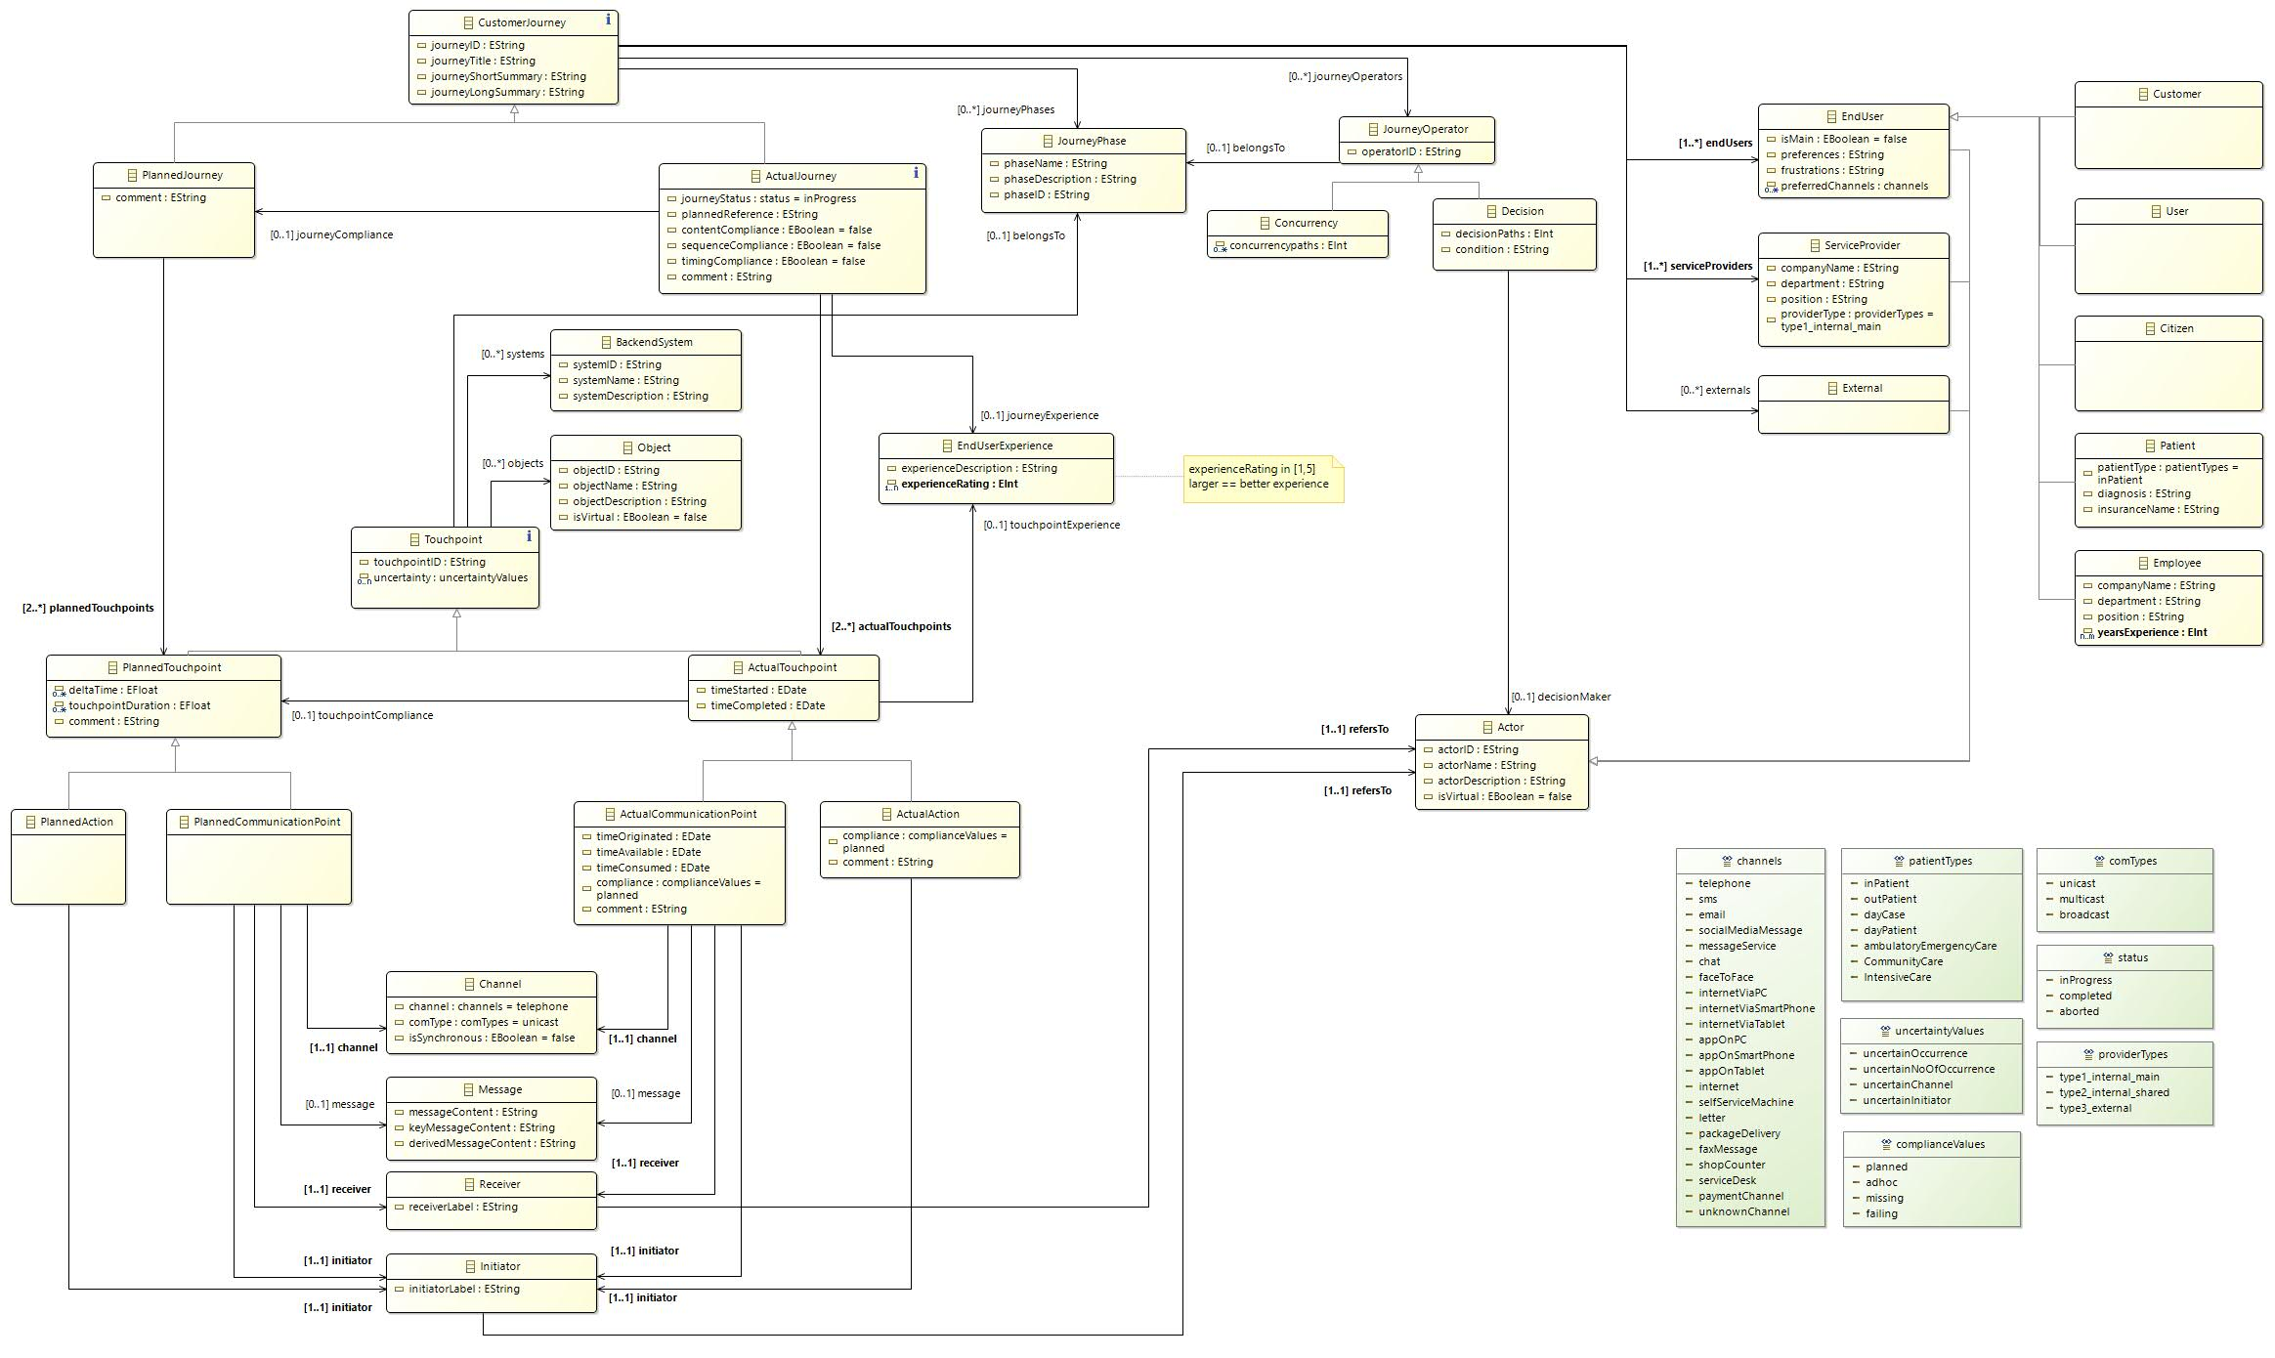
CJML complete metamodel – validated using EMF eCore

Slide 45
References
Akehurst, D.H. and Patrascoiu, O. (2003). Tooling metamodels with patterns and OCL, in: Proceedings from the workshop Metamodelling for MDA, York, UK, pp. 203-215.
Edvardsson, B. and J. Olsson (1996). Key concepts for new service development. Service Industries Journal 16(2), 140-164.
Edvardsson, B., Gustafsson, A. and Roos, I. (2005). Service portraits in service research: a critical review. Int. J. Serv. Ind. Manag. 16, 107–121.
Evans, A., Sammut, P. and Willans, J.S. (2003). Metamodelling for MDA, in: Proceedings from the workshop Metamodelling for MDA, York, UK, pp. 1-8.
Grönroos, C. (2001). Service management and marketing. Wiley New York NY.
Holmlid, S. and Evenson, S. (2008). Bringing Service Design to Service Sciences, Management and Engineering. In Service Science, Management and Engineering Education for the 21st Century: Springer, 341-5.
ISO (2019): Ergonomics of Human-system Interaction: Part 210: Human-centred Design for Interactive Systems. International Organization for Standardization, Switzerland (2019)
Koivisto, M. (2009). Frameworks for structuring services and customer experiences. In S. Miettinen & M. Koivisto (Eds.), Designing Services with Innovative Methods (pp. 136-149). Helsinki: University of Art and Design, Helsinki.
Mellor, S.J. (2004). MDA distilled: principles of model-driven architecture. Addison-Wesley Professional.
Osterwalder, A. (2004). The business model ontology: A proposition in a design science approach. PhD thesis. University of Lausanne, Ecole des Hautes Etudes Commerciales, Switzerland.
Shostack, G. L. (1982). How to design a service. European Journal of Marketing, 16(1), 49-63.
Stickdorn, M. and J. Schneider (2011). This is service design thinking. Amsterdam, BIS Publishers.

